Slide 1
WASC
LCAP, LAUSD GOALS, FHS GOALs
Tuesday, April 24th
Courtesy of BA Rory Seidman at Franklin HS

Slide 2
WASC Background Local Control Funding Plan = Local Control and Accountability Plan (LCAP)
On July 1, 2013, Governor Jerry Brown signed into law the new Local Control Funding Formula (LCFF), which significantly changes how California funds its K-12 schools and gives school districts more authority over how the money will be spent.
The thrust of the new system is to encourage self-improvement and to provide support to schools that fail to show progress in the eight LCAP priority areas.
Notes:
The district has to account to the state for the way funds are spent based on the following 8 LCAP priorities

Slide 3
Eight LCAP priority areas Why is this important to us?
WASC revamped report to include the Eight LCAP priority areas.
Basic Services: Providing all students access to fully credentialed teachers, instructional materials that align with state standards, and safe facilities.
Implementation of California’s academic standards, including the Common Core State Standards: Implementation of California’s academic standards, including the Common Core State Standards in English language arts and math, Next Generation Science Standards, English language development, history social science, visual and performing arts, health education and physical education standards.
Notes:
WASC has changed its format and now requires every school to use the 8 LACAP priorities
You have a hand out! The main key requirements are Basic Services & Implementation of CA academic standards CC, ect.

Slide 4
Eight LCAP priority areas
3. Parent Involvement: Parent involvement and participation, so the local
community is engaged in the decision-making process and the educational programs of students.
4. Student Achievement: Improving student achievement and outcomes along multiple measures, including test scores, English proficiency and college and career preparedness.
5. Student Engagement: Supporting student engagement, including whether students attend school or are chronically absent.
Notes:
Key requirements
Parent Involvement, Student Achievement, Student Engagement

Slide 5
Eight LCAP priority areas
6. School Climate: Highlighting school climate and connectedness through a variety of factors, such as suspension and expulsion rates and other locally identified means.
7. Course Access: Ensuring all students have access to classes that prepare them for college and careers, regardless of what school they attend or where they live.
8. Other Student Outcomes: Measuring other important student outcomes related to required areas of study, including physical education and the arts.
Notes:
The last three of the Key requirements School Climate, Course Access, Other Student Outcomes

Slide 6
LCAP & LAUSD
LAUSD is being held accountable for the State funding. All districts must follow the 8 priorities.
Los Angeles School District has to take these 8 key requirements and create goals.

Slide 7
GOAL # 1 100% Graduation
2955 × 1989 - ssu.edu
LCAP Priorites:
5. Student Engagement 7. Course Access
6. School Climate 8. Other Outcomes

Slide 8
FHS Meets these goals
Monitor & support high school graduation rate
Increase A-G Requirement Completion
Increase ELA EAP Proficiency
Increase Math EAP Proficiency
Monitor & reduce drop- out rate
Increase Individual Graduation Plan Meetings

Slide 9
GOAL #2: Proficiency for all
LCAP Priorities
2. Academic Standards
4. Student Achievement
7. Course Access

Slide 10
FHS Meets these goals
Increase 8th & 11th ELA Standards Proficiency
Increase 8th & 11th Math Standards Proficiency
Increase Reclassification rate for ELs
Increase English Learners progress on ELCAP
Decrease LTELS (Long Term English Learners)
Inclusion of SPED into General ED (Increase SPED in General Ed 80% of day

Slide 11
GOAL #3 100% Attendance
LCAP Priorities
5. Student Engagement

Slide 12
FHS Meets these goals
Increase students attending 180+ school days
Decrease chronic absenteeism

Slide 13
GOAL #4: Parent, community & student engagement
LCAP Priorities
3. Parent Involvement
6. School Climate

Slide 14
FHS Meets these goals
Increase students feeling connected
Increase parents completing Social Emotional Support (SES)
Increase Parent Academic Initiative training
Increase Parents reporting resource access

Slide 15
Goal #5 Ensure School Safety
LCAP Priorities
6. School Climate
8. Other Outcomes

Slide 16
FHS Meets these goals
Decrease single student suspension rate
Decrease instructional days lost to suspension
Maintain or reduce low expulsion rate
Increase school with discipline foundation policy

Slide 17
GOAL #6 Provide Basic Services
LCAP Priorities
1. Basic Services
5. Student Engagement

Slide 18
FHS Meets these goals
Teachers appropriately credentialed
Increase Performance Educator Development and Support: Teachers (EDST) Performance Evaluations (new stull)
Increase school based staff attendance 96%+
Williams compliance instructional materials
Maintain facilities in good repair

Slide 19
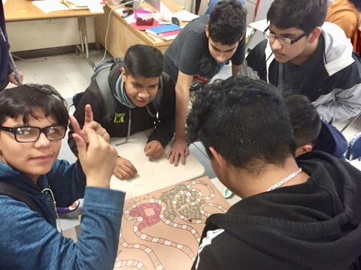
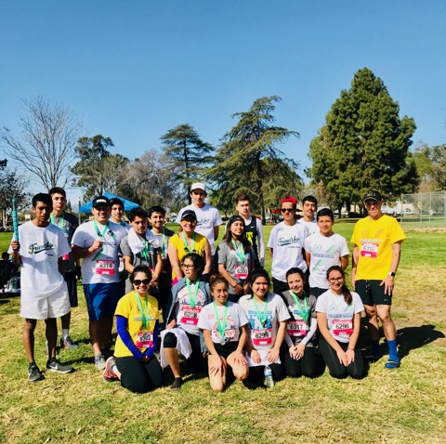
LAUSD goals & FHS
Support the following:
Franklin High Students
Also, our English Learners, Long Term English Learners, Low Income students, and our Foster Youth!
WE DO MAKE A DIFFERENCE!

